Slide 1
Nasonex® Direct-to-Consumer TV Advertising:
Sales Impact & ROI Evaluation – Internal Discussion
Promotion Response Analytics
Commercial Analytics
US Commercial Operations

Slide 2
Background and Agenda
The objective of this project is to estimate sales impact and return-on-investment for Nasonex® direct-to-consumer television advertising using marketing mix modeling.
Agenda:
  Important Results
  Process Automation: Processing Nielsen’s GRP data to compute Adstocks.
  Modeling Process, Data Visualization and Issues
  Model Structures and Understanding Estimate Bias (through Prof. Allison’s ideas on Random and Fixed Effects models)
  Identifying Saturation: Parametric, Non-Parametric and Semi-Parametric approaches
  Understanding model structures through Simulations
  Exploring Residuals, acceptable Covariance Structures and Half-Life’s (or Adstocks)
  Influence Diagnostics and Outliers
  Final and Supporting Models

Slide 3
Results

Slide 4
Summary of Results
This analysis suggest that investments in Nasonex® TV media, production, talent and agency fees were profitable during the studied time period (August 2009 through July 2011) with an approximate ROI of $2.7:$1. [95% confidence interval: 1.6 to 3.7]
Program Cost: $84.4 MM; Incremental Revenue (before tax): $225MM; Planned 2012 Spend: ~28MM to 30MM.
The modeling approach suggests:
  that within the experience range the response is linear and does not show any saturation
  that an increase in media investment of approximately $5MM vs. historical investments may increase the profits from the investment by $10MM.
  Second half of the year is more impactful per Ad than the first half of the year.
  The total TV DTC impact in first half of 2011 was not statistically different from the corresponding time period in 2010.
  By holding the current spend during first semester and increasing the second semester GRPs by $1MM, an estimated additional incremental revenue of about $5.9MM may be possible (a more conservative estimate would be about $3.6MM).
Notes:
Cover Full

Slide 5
Model Findings
Impact of various drivers of NRx volume agrees directionally well with the expectations. Total Nasonex TV DTC activities account for approximately 14.5% of Nasonex NRx during the study period. OTC TV DTC has negative impact on Nasonex NRx volume.
Drivers | Impact on Nasonex NRx | Statistical Significant? | Annual % Contribution towards Nasonex NRx (approx.)
Details | Positive | Yes | + 5.2%*
Samples | Positive | Yes | + 9.5%*
Managed Care Influences [% Non-Restricted] | Positive | Yes
Nasonex® TV DTC During 1st Semester | Positive | Yes | + 6%
Nasonex® TV DTC During 2nd Semester | Positive | Yes | + 8.5%
Omnaris® TV DTC | Positive | No
OTC TV DTC: Allegra® + Claritin® + Zyrtec® | Negative | Yes | - 7%
Lagged NRx (brand equity) | Positive | Yes
Contribution from Nasonex TV DTC campaign is approximately similar to contributions from Details and Samples taken together.
* Approximate values from separate physician level model (PRA) are represented here. Current model detail and sample estimates tend to have aggregation bias. Hence values from the PRA models were used here.
Study Period: Aug-2009 to Jul-2011

Slide 6
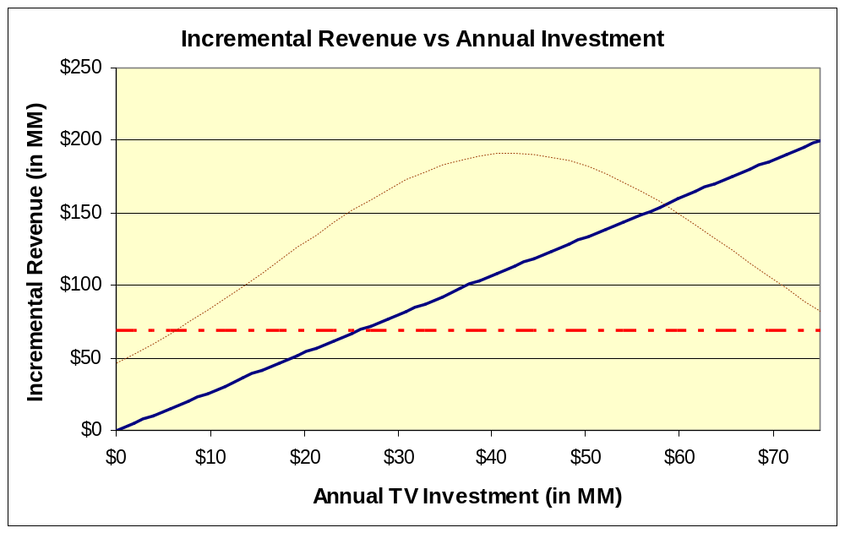
Incremental Revenue by Total pre-tax Investment
This incremental revenue vs. pre-tax annual DTC TV spend chart shows a revenue of about $112MM for the average pre-tax annual TV DTC spend of about $42MM. The estimates have higher confidence in the narrow range around the mean annual spend.
Historical annual TV investment
Dotted red line represents the incremental revenue lost to OTC TV Ads.
The modeled curve is linear, implying that as DTC spend increases, the revenue also increases proportionately. Further non-parametric studies suggests that within the data experience range, the saturation effect could not be observed.
The dotted red line shows the revenue loss due to OTC TV Ads during the year. About $26 MM of Annual TV investment is required to negate the impact of OTC TV Ads on Nasonex NRx. In addition, after Allegra OTC launch in March 2011, the TV spend for Allegra OTC has increased drastically, hence moving forward, a higher negative impact of OTC TV ads may be observed.
Study Period: Aug-2009 to Jul-2011

Slide 7
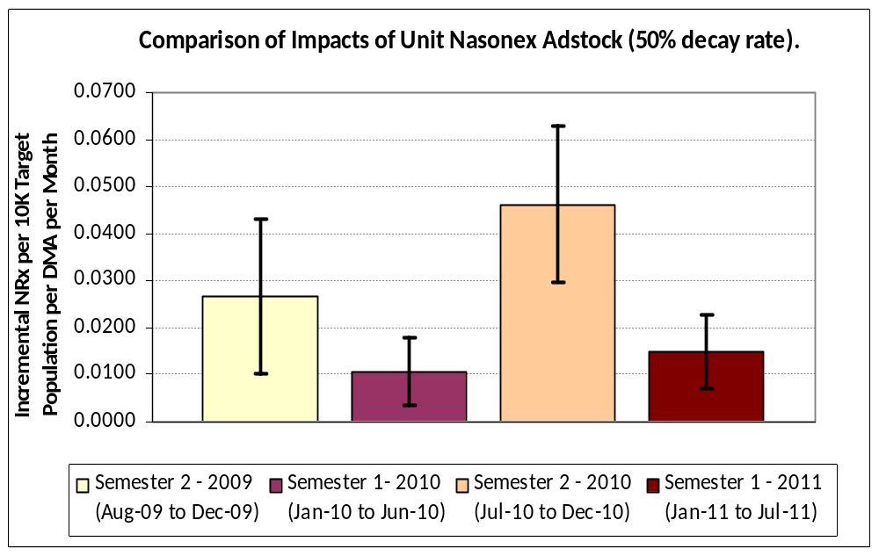
TV Campaign Impacts across Semesters
Per :60 second GRP Adstock, First half of 2011 was as effective as that of 2010. Also, per Adstock, Semester 2’s are more responsive than Semester 1.
Second half of the years (Semester 2’s) are more responsive per GRP Adstock than First half of the years (Semester 1’s).
First half of 2011 is as responsive (per weighted GRP Adstock) as Semester 1 of 2010 as their confidence intervals overlap.
This represents 95% confidence Interval. For first half of the year, both 2010 and 2011 estimates overlaps, suggesting that they are not different statistically.
Semester level estimates here were obtained from supporting models. They are more appropriate in making relative comparisons.
Study Period: Aug-2009 to Jul-2011

Slide 8
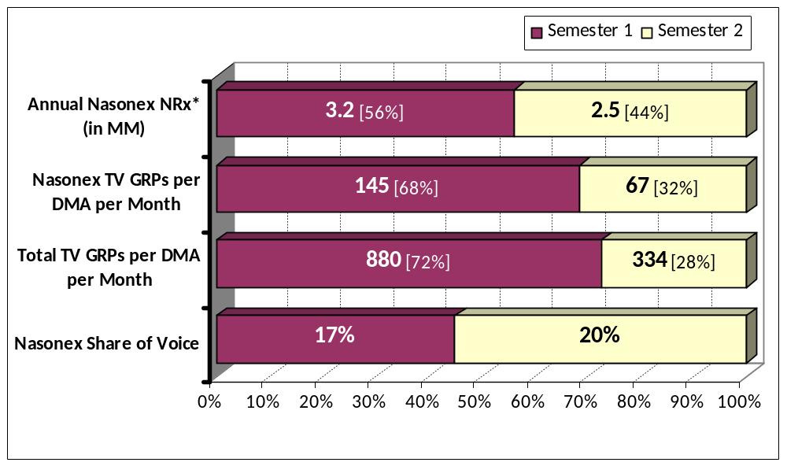
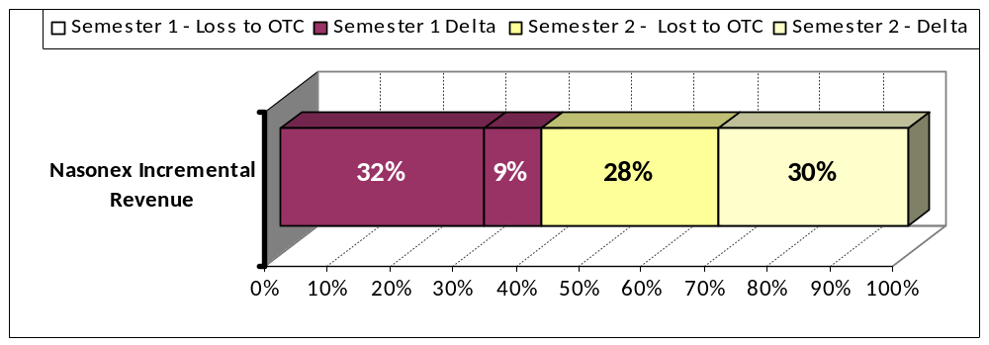
TV Campaign Trends: First and Second Semesters
Total TV Voice in Semester 2 is much lower than Semester 1. Semester 2 contributes about 59% of total 3 year pre-tax revenue generated. Semester 1 Ads are mostly spent in negating the effects of OTC Ads.
Nasonex NRx in first half of 2010 is about 56% of total NRx in 2010.
Semester 1 Nasonex TV GRP is about 68% of yearly GRPs. This % is higher when compared to NRx split.
Total voice in Semester 2 is much lower than in Semester 1.
OTC TV campaigns have a negative impact on Nasonex NRx.
  In Semester 1, most of the Nasonex TV campaign just goes to negate the effects of high OTC campaigns during these periods.
Since the launch of Allegra OTC in 2011, their TV campaigns have increased substantially and probably all the Nasonex Semester 1 campaign effects are negated by the OTC campaign.
One recommendation would be to hold the Semester 1 GRPs at current (or slightly higher) level and increase the Semester 2 GRPs to achieve a higher annual incremental revenue.
Annual NRx in the chart is based on year 2010.
All other metrics are study period averages per DMA per Month
Study Period: Aug-2009 to Jul-2011

Slide 9








Modeling Process Summary
Time-series cross sectional regression models estimate incremental monthly-DMA level NRx volume due to brand TV advertising while controlling for prior NRx volume, field promotion, managed care access, market events, and competitive advertising.
Product NRx
DMA Population
Nasonex
GRP Adstock
Competitors
GRP Adstock
Concurrent
Promotions
# of Prescribers
Pre-period
Product NRxs
DMA Population
Managed Care
Access (%)
Variables for Each Month for Seasonality and Market Events
# of potential
=
+
+
+
+
+
Nasonex NRx for a given month within a DMA per 10K adults in 21-54 age group in the DMA is calculated to “population normalize” scripts, effectively putting DMA-month level prescription volume on a common scale across DMAs.
Adstocks created from Nasonex GRPs are already on a common reach-like scale.
Nasonex Adstocks were modeled using two interaction terms based on first and second half of the year. This was done to study the differential impacts of first and second semesters of a given year.
Other promotional variables (details, samples) per 1,000 prescribers in the DMA are computed to normalize the promotional variables across DMAs.
Carryover script writing regardless of promotions (brand equity) is accounted by including normalized pre-period Nasonex NRx.
Non-Restricted formulary access (expressed as %) for Nasonex is used to control for Managed Care influences.
Variables for each month were introduced to control for seasonality and market events such as effects of generic Fluticasone growth on Nasonex NRx, Fluticasone supply issues, Allegra OTC launch etc. These variables also provide overall control for other online promotions, vouchers, coupons and other unknown influences across time to the extent they could be captured.
Omnaris and OTC TV ad exposures were explicitly controlled. OTC products here include Allegra, Zyrtec and Claritin as one bucket. These three OTC brands had a large voice in terms of TV Ads. After Allegra OTC launch in Feb/2011, its TV Ads had increased substantially, and this is captured by combined OTC TV GRP bucket.
A Random Intercept model was constructed to further account for unobserved DMA specific effects.
The output is the average incremental NRx volume per month per 10K target population.

Slide 10
Process Automation: Processing Nielsen’s GRP data to compute Adstocks

Slide 11
Process Summary and Data Organization
A simplified and flexible automation process was developed to load GRP data and compute adstocks based on configuration through Access DB tables. Potentially saves many days of effort.
Organization of GRP Data - A set folder structure:
  Nielsen_Data_Processing
    CONFIG
      CONFIG_GRP_PROCESS.mdb
    INPUT
      Nielsen_Nasonex_Inputs.mdb
      All Input Text files from Nielsen (LOCAL TV, LOCAL MULTI, NATIONAL TV, NATIONAL MULTI)
    LOGS (has all SAS logs and lists)
    OUTPUT (has processed and few intermediate datasets)
      Ads_by_full_week [has weekly adstocks if configured]
      Ads_by_unit_month [has monthly adstocks by considering monthly GRP’s]
      Adstk_aggr_by_month [has monthly adstocks by aggregating corresponding weekly adstocks]
    SAS_PGM
      Process GRP MAIN DRIVER.sas [Driver Program to Run. Calls programs 2 to 4 internally]
      1 Import GRP Data.sas [Loads raw GRP files to standardized Input access tables]
      2 Compute Wtd GRPs by Week.sas
      3 Include MM Metrics by Week.sas
      4 Compute Adstocks.sas

Slide 12
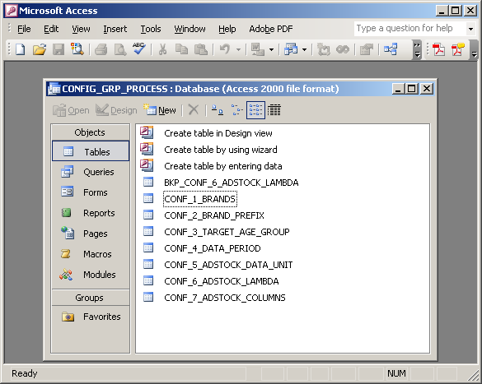
Configuration Tables and Process Flow
Load Raw Data to Access
(SAS Pgm 1)
Configuration
(Access Tables)
Input Raw Data
(Access Tables)
MAIN DRIVER
(Driver SAS Program)
Functional Macros
(SAS Pgms 2 to 4)
Output Data
(SAS Adstock
Datasets)
Raw text files are initially loaded to Access tables with standard column names.
Seven Configuration tables.
User mainly inputs the configuration table and runs Main Driver.
The Main Driver has short blocks of code (named as steps). Each block starts with few lines for reading configurations and a call to corresponding macro program (user has to uncomment the call while running the corresponding block).

Slide 13
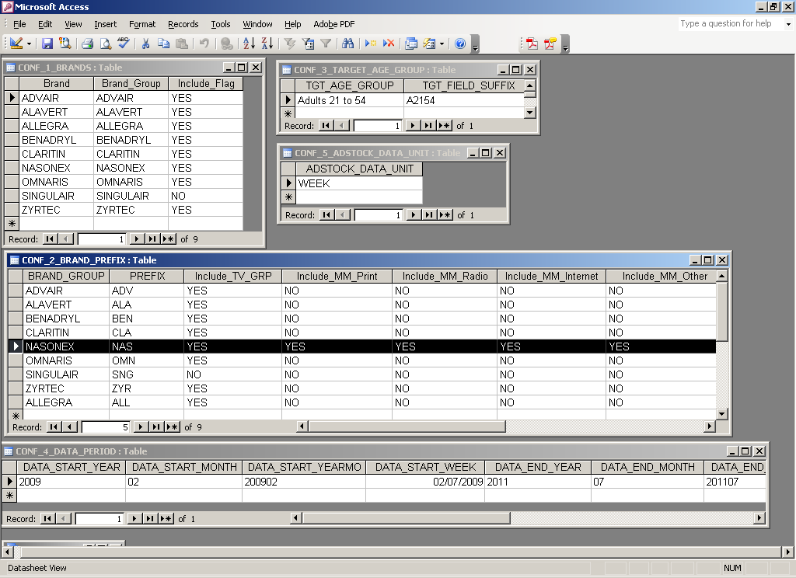
Contents of Configuration Tables: Page 1 of 2

Slide 14
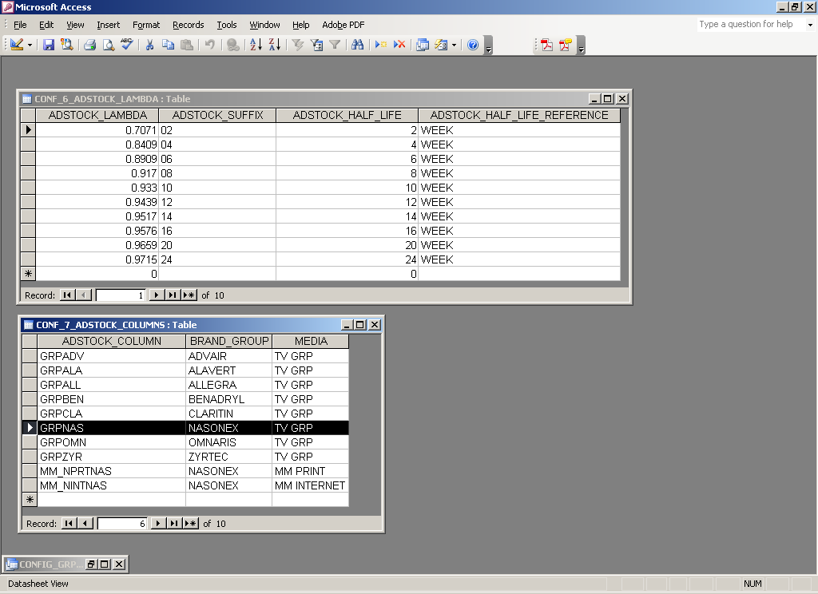
Contents of Configuration Tables: Page 2 of 2

Slide 15
Modeling Process, Data Visualization and Issues

Slide 16
Dimensions to Explore: Art and Science
Start with few most relevant and complete model structures that addresses business concerns.
  Based on Visualization, available data, missing data, data correlations, past experiences and business questions
Understanding bias in the estimates: Exploration through Prof. Allison’s ideas.
  OLS ➔ Robust Std. Errors ➔ Random Effects ➔ Fixed Effects ➔ Hybrid Methods
Exploring shape of DTC response curves (i.e., looking for Saturation): Parametric, Non-Parametric and Semi-Parametric approaches.
  Polynomials, LOESS, GAM (Splines and Loess)
Model Structure selection (or tuning) through Simulation
Covariance Structure exploration for repeated measures and/or random effects
  Variograms, convergence issues and residual error structures.
Exploration of acceptable Half Life’s
Influence Diagnostics and Removal of Outliers
Loop through above steps several times to converge on Final Model.
Some supporting models may also be necessary to provide evidence of what we are concluding from the analysis.
Notes:
Cover Full

Slide 17
Nasonex DTC: Available Data
TV GRP’s from Nielsen (by report week): Nasonex, Omnaris, Allegra, Claritin, Zyrtec and others like Advair, Alavert, Benadryl and Singulair.
TV GRP’s include Local TV (210 DMA) and National TV GRP’s for households and few specified target population ranges. TV Spends were also included.
Multi Media Spend and Occurrences (by report week) for above products and target ranges. Many fields were zeros and were not usable.
Rx, Details, and Samples data from Grail. Physician’s zip code to DMA mapping was done.
DMA to Zip code mapping from Nielsen. DMA Name to DMA code mapping from Nielsen (with some internal manual corrections and dedupes).
GRP flighting pattern and actual Spend from Media team – National Level.
National level Print and Online spend by month from media team. DMA level would be ideal but couldn’t get them. A weighted online score was developed by standardizing and combining different online program impressions.
Production costs, Agency costs and Talent costs from several vendors (contact Charlie as a start).
Vouchers and Coupon redemptions from McKesson (national) and SAM (zip level). Data issues and mismatching prevented us in its use.
Various market events from Marketing. Main events were Fluticasone growth, Fluticasone shortages during spring 2010, change in field forces and field promotion levels and heavy Allegra ads.
Managed care metrics from Jeff’s team.
Notes:
Cover Full

Slide 18
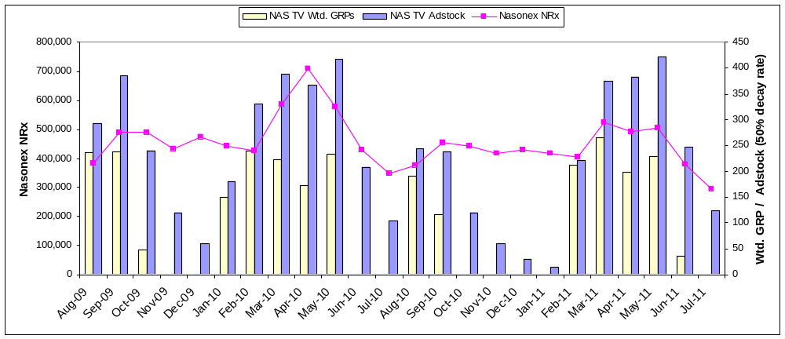
Analytical Time Period
The analytical period assessed in this analysis is August 2009 through July 2011. GRPs for the target population are weighted to 60 second durations and transformed to adstock to capture the lagged effects of TV on NRx volume. The NRx and GRPs vary similarly with peaks during seasonal months. From 2010, the weighted GRPs are reduced when compared to previous levels.
Study Period Starts here
Fall Seasonal Months.
Primary Allergy Season.
Allegra OTC launched in March 2011. Allegra OTC greatly increased TV Ads. From March 2011.
Study Period Ends here
Primary Allergy Season.
Fluticasone Shortage in April and May 2010
Fall Seasonal Months.
GRPs are for Adults aged between 21 to 54 years (Target Population).
Study Period: Aug-2009 to Jul-2011

Slide 19
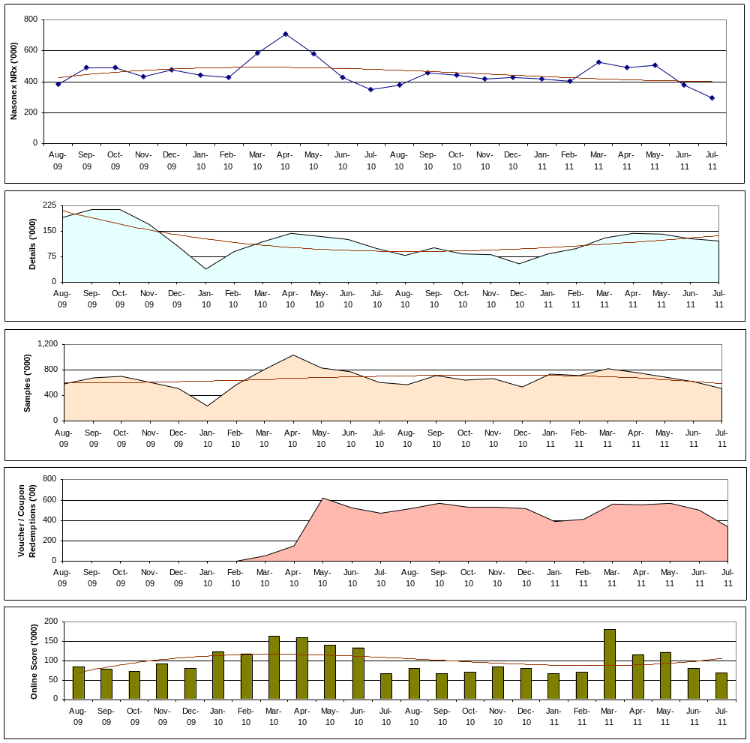
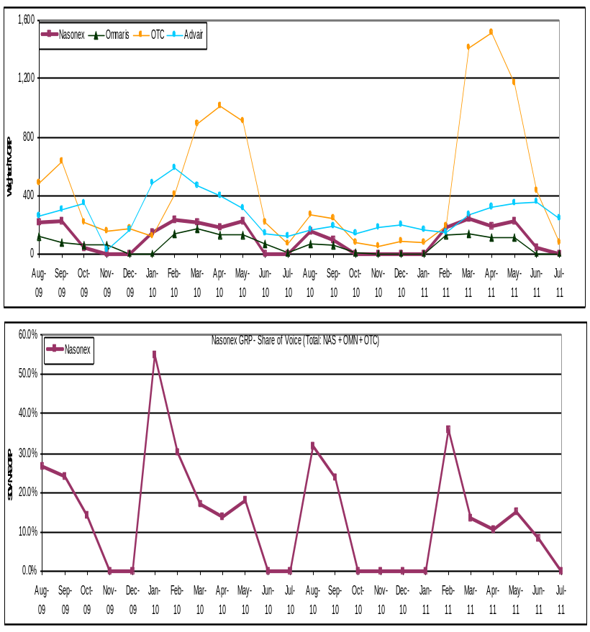
Trends of Nasonex NRx, Details, Samples, Coupons, Online Impressions,
Notes:
All are correlated. Season’s differ. Voucher/Coupon data issues. Ads going together and a need to consider only relevant products (i.e., taking into Marketing’s perspective).

Slide 20
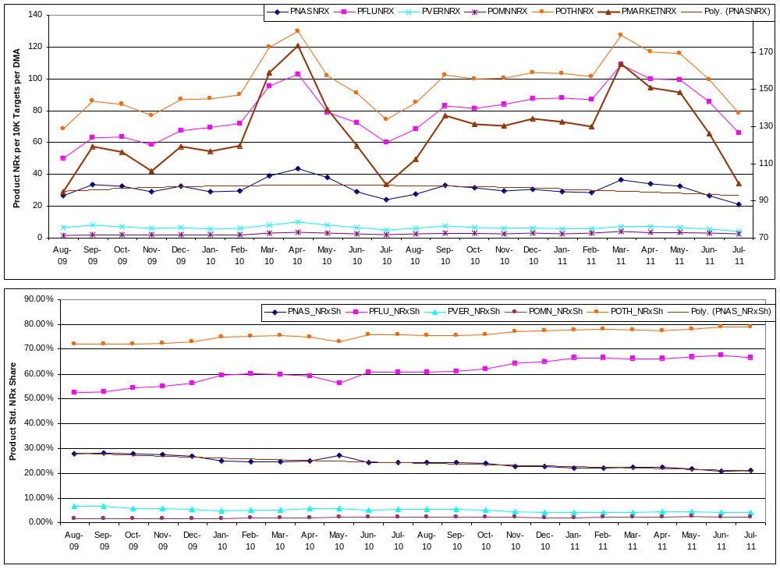
Trends of Population Normalized NRxs and Shares of Nasonex, Fluticasone, Veramyst, Omnaris, All Competitors, and Market
Notes:
All NRx’s going together. Growth of Fluticasone share and Fall of Nasonex and other product shares.

Slide 21
Data Layout: Fields in Analytic Dataset
DMA YEARMO
NRx / TRx: NASNRX MKTNRX FLUNRX VERNRX OMNNRX NASTRX MKTTRX FLUTRX VERTRX OMNTRX
Promotions: DET SAM vch_rdm cou_rdm vcr ONL_SCORE ONL_SCORE_50
Demographics: POP_21_54 HH_AVG_INCOME workdays
Managed Care Metrics: mc_rp mc_nrp mc_offp
TV and Print: GRPALL GRPCLA GRPNAS GRPOMN GRPZYR GRPOTC MM_NPRTNAS
TV and Print - Adstocks: GRPALL_10 GRPCLA_10 GRPNAS_10 GRPOMN_10 GRPZYR_10 GRPOTC_10 MM_NPRTNAS_10
....................................................
20,30,40,50,60,70,75,80,85,90
....................................................
Population Normalized Rxs: PNASNRX PMKTNRX PFLUNRX PVERNRX POMNNRX PNASTRX PMKTTRX PFLUTRX PVERTRX POMNTRX
Normalized lags, promotions and their Adstocks: lag_pnasnrx detmd sammd vcrmd detmd_10 sammd_10 vcrmd_10 .....
GRP polynomial terms and Adstocks: grpnas_sq grpnas_10_sq .......
Indicator Variables: q1 q2 q3 q4 SEMESTER jan -- dec flut_short_ind gen_all_launch

Slide 22
Model Structures and Understanding Estimate Bias:
Prof. Allison’s ideas on OLS, Random and Fixed Effects models
Reference: Fixed Effects Regression Methods for Longitudinal Data by Paul D. Allison

Slide 23
Concepts – Randomized Experiments vs. nonexperimental studies.
Randomized experiments have major advantages over observational studies in making causal inferences.
Randomization ensures treatment groups, on average, are identical with respect to all possible characteristics of the subjects, regardless of whether they could be measured or not.
In nonexperimental studies, we try to approximate random experiment by statistically controlling for other variables using methods such as linear regression, matching etc., This has two major drawbacks
  Its possible to leave out some crucial variables. Omission of a key covariate can lead to severe estimation bias for the variables that are included.
  Not all variables could be measured. Inaccuracies in measurement also causes estimation bias.
In practice, causal inference via statistical adjustment usually runs distant second to randomization. However, with certain kinds of nonexperimental data (ex: longitudinal repeated measures data) we can get much closer to the virtues of a randomized experiment.
Specifically, by using fixed effects method discussed in the reference, it is possible to control for all possible time-invariant characteristics of the individuals in the study (measured or not).

Slide 24
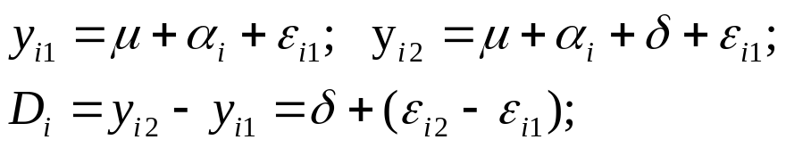
Concepts – Fixed Effects Methods
In essence, each individual serves as his or her own control in FE methods.
  This is accomplished by making comparisons within individuals and then averaging those differences across all individuals.
  Major attraction in nonexperimental data is the ability to control for all stable characteristics of the individuals in the study, thereby eliminating potentially large sources of bias.
Example: Paired-Comparison t-test.
Fixed effects methods ignores between-person variation and focuses only on within-person variation.
  Disadvantage: Discarding between-person variation can yield standard errors that are considerably higher than those methods that use both within- and between-person variation.
  Advantage: Between-person variation is very likely to be contaminated by unmeasured personal characteristics that are correlated with dependent and/or other independent variables. By restricting ourselves to within-person variation, we eliminate that contamination and are much more likely to get unbiased estimates.
We are dealing with the trade-off between bias and sampling variability. For nonexperimental data, fixed effects methods tend to reduce bias at the expense of greater sampling variability.
Fixed effect methods do not provide an estimate for time-invariant variables. Interactions between time-invariant and time-variant vars could be estimated.

Slide 25
Concepts – Fixed Effects Methods (cont’d)
Random effects methods do not control for unmeasured, stable characteristics of the individuals. This is because α_{i} terms are usually assumed to have a distribution that is uncorrelated with the measured variables in the model.
  They use both within and between individual variations and typically have less sampling variability than fixed effects methods.
DECISION to use Fixed or Random Effects methods depends on:
  Is it important to control for unmeasured characteristics of individuals to reduce bias in the estimates of interest? (use FE Methods)
  Is it important to estimate the effects of stable covariates? (use RE or Hybrid Methods)
  Whether one can tolerate the substantial loss of information that comes from discarding the between-individual variation (cannot tolerate → use RE methods)
WHY did we use this exploration for Nasonex DTC study?
  Mainly to understand and reduce the biasness of various parameter estimates of interest (particularly, TV DTC promotions)
  To see if our data supports using FE methods and still achieve reasonable significance levels.
  Compare how the biasness varies for various model structures (with an aim to find relatively appropriate structures)

Slide 26

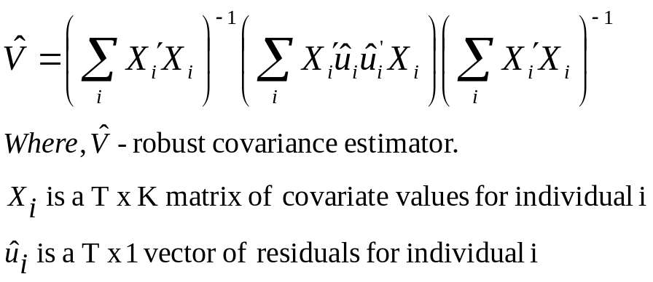
OLS / RE / FE Methods Exploration - 1
Basic Model
  Y_{it,} X_{it} is response and time variant variables for individual i and time t. Z_{i} time-invariant variables in the model
  ε_{it} is random error with mean 0 and constant variance, uncorrelated with x and z. β, γ parameter estimates. Different intercepts at each time point, coefficients are same across times.
OLS (PROC REG):
  Coefficients will be unbiased but NOT efficient (true standard errors will be larger than necessary)
  Estimated standard errors and p values will be too low because error covariance across time ≠ 0.
Solution 1 - Robust Standard Errors (PROC GENMOD):
The matrix V cap contains variances of the
coefficients on the main diagonal and between
coefficients off the diagonal.
The robust standard errors are the roots of the
main diagonal elements.
  Although coefficients are same as OLS,
  Robust standard errors are larger for vars
  with higher between individual variances.
  PROC GENMOD DATA=abc;
  CLASS dma yearmo;
  MODEL y = x1 x2 x3 z1 z2 z3;
  REPEATED SUBJECT=dma / TYPE = IND;

Slide 27
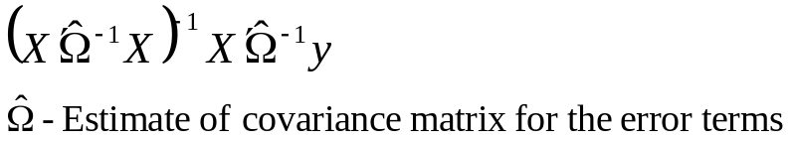
OLS / RE / FE Methods Exploration - 2
Solution 2: Generalized Estimating Equations (GEE) :
  It produces EFFICIENT estimates of the coefficients (i.e., true standard errors will be optimally small). GEE does this by taking the over-time correlations into account when producing the estimates.
  GLS estimates are obtained by the formula:
  Omega cap is not included in OLS estimates.
  Omega cap is typically block diagonal and user specified (UN, AR, EXCH, MDEP(m) etc.,).
  GEE estimates are accompanied by robust standard error estimates in GENMOD
  GEE with EXCH structure is technically same as Random Intercepts model.
  PROC GENMOD DATA=abc;
  CLASS dma yearmo;
  MODEL y = x1 x2 x3 z1 z2 z3;
  REPEATED SUBJECT=dma / TYPE = UN CORRW;

Slide 28

OLS / RE / FE Methods Exploration - 3
Extended Model
  α_{i} represents all differences between individuals that are stable over time and not otherwise accounted for by z’s. It can be said to represent “unobserved heterogeneity”.
Solution 3: Random Effects (Mixed) Models (PROC MIXED):
  α_{i} is assumed as N(0,Τ²) and is UNCORRELATED with x, z, and error term.
  Random effects models do not really control for unobservable variables because of the above assumptions.
  One advantage is to test whether variance of α is 0, which is equivalent to testing for dependence among the observations.
  Can be extended to allow for random coefficients.
  Use TSCSREG to do Haussman test to verify if we need to consider FE model (i.e., RE vs. FE model).
  EMPIRICAL option below provides robust standard errors.
  PROC MIXED DATA=abc COVTEST EMPIRICAL;
  CLASS dma yearmo;
  MODEL y = x1 x2 x3 z1 z2 z3 / SOLUTION;
  RANDOM INTERCEPT / SUBJECT=dma;

Slide 29
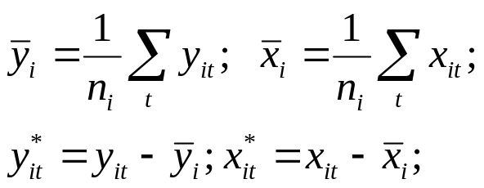
OLS / RE / FE Methods Exploration - 4
Extended Model
  α_{i} is treated as a set of fixed constants, one for each individual. This allows it to be correlated with x, and z.
Solution 4: Fixed Effects Models (PROC GLM):
  Fixed effects methods not only produce standard errors that adjust for dependence, they also control for all stable characteristics of the individuals, whether observed or unobserved.
  Conventional Fixed Effects will NOT produce coefficient estimates for time-invariant predictors (since α_{i} is perfectly collinear with z_{i}).
  One trick to simplify the estimation is to “condition out” the α_{i}’s. Conditioning out is achieved by centering the individual level vars across time for each individual. Then, regress the centered variables along with time indicators.
  This is automatically done using ABSORB statement in PROC GLM.
  PROC GLM DATA=abc;
  ABSORB dma;
  CLASS yearmo;
  MODEL y = yearmo x1 x2 x3 / SOLUTION;

Slide 30

OLS / RE / FE Methods Exploration - 5
Solution 5: Fixed Effects Models (cont’d)
  Fixed effects methods use only variation within individuals to estimate the coefficients.
  A consequence is that standard errors tend to be larger for FE models than for RE or GEE.
  Each individual serves as his or her own control.
  In sum, FE methods reduce bias but at the expense of increased standard errors.
  If there’s very little variation within individuals, FE methods are not useful.
Solution 6: Hybrid method (PROC MIXED)
  Extends the virtues of FE and RE methods. Produces FE estimates for time-varying predictors and RE estimates for time-invariant predictors.
  Provides a test of FE vs. RE models for each of the time-varying parameters.
  Can be extended to allow for random coefficients and more complicated error structures.
  Basic Idea:
    Decompose each time-varying predictor into within and between individual values.
    Put both parts in RE model along with z and time indicators.
    Test whether coefficients for the two parts are same (using CONTRASTS).

Slide 31
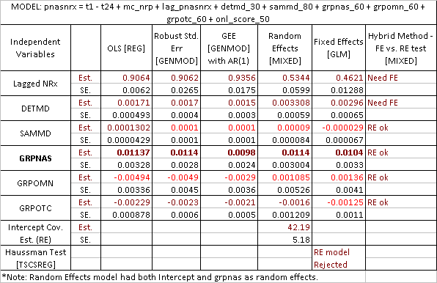
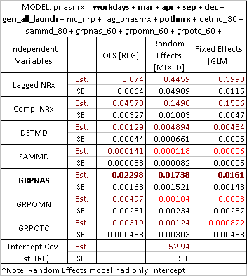
OLS / RE / FE Methods - Example
Note changes in Lagged NRx and Details (while non significant samples)
Stability differences in GRPNAS and GRPOTC in both tables
A very different values for GRPNAS across two tables (a possible pointer to model structure issues)

Slide 32
Identifying Saturation: Parametric, Non Parametric and Semi-Parametric methods

Slide 33
Parametric Methods
Add squared and/or cubic terms for GRPNAS and look for significance levels for these terms. [For this project, higher order polynomials were not significant and resulted in high VIF]
Look for inverted “U” or diminishing returns patterns.
Log transformation would impose diminishing return curves, however, care should be taken not to impose if the shape does not exist in the reasonable experience range (i.e., there is no visual confirmation of its existence through other methods).
  Past experience seems to suggest that it over-predicts the impact when the shape is linear in the experience range and in the far higher promotion levels (with very few records) the response is flat.
Experiments with Orthogonal Transformations: Legendre Functions
  A variable "x" could be translated to following orthogonal functions
  Order 1: x Order 2: 0.5*(3*x*x - 1) Order 3: 0.5*(5*x*x*x - 3*x)
  for more orders and details, refer to: http://en.wikipedia.org/wiki/legandre_polynomialsAa
  Model these transformed variables instead of squared or cubic terms.
  Visual exploration shows that complex shapes could be represented by these orthogonal functions.
  RESULT: NO OBSERVABLE CHANGES from polynomial models (both in terms of estimates and std errors), though VIF’s improved for the higher order polynomial terms.
Notes: May be a good place to discuss similar experiences with ORTHOREG and Principal components for selected params (like Details and Samples).

Slide 34
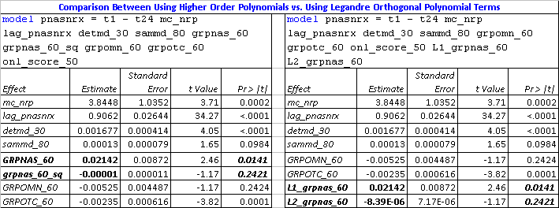
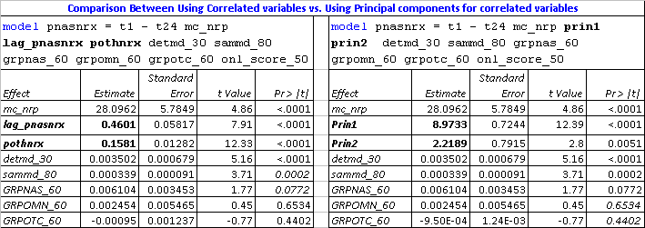
Examples: Using Legendre Polynomials and Principal Components for Correlated Fields.
Legandre Polynomials
No material changes in estimates and std. err.
Principal Components
No material changes in estimates and std. err. for variables of interest.

Slide 35
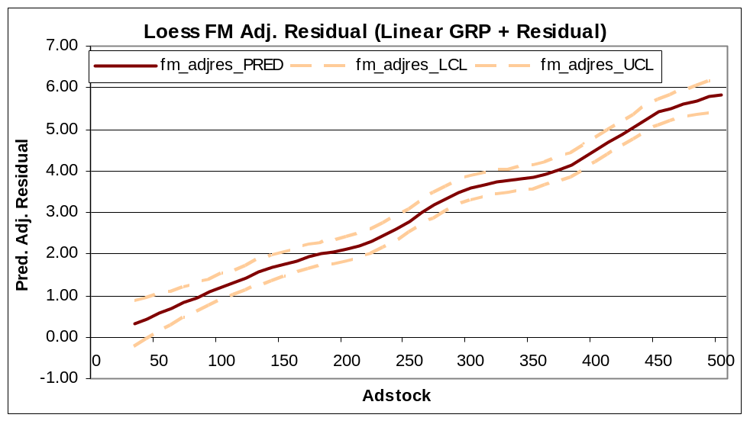
Non-Parametric Methods [PROC LOESS]
Algorithm works by considering local regression trees and smoothing various local predicted values. No constraints on shapes are assumed.
Does not support more than 15 variables. Convergence becomes hard (or mostly impossible) for more than about few thousand observations.
One way to simplify implementation is to first build full mixed model, take its residuals and add predicted values from Nasonex GRPs. Then model these adjusted residuals vs. GRPNAS.
proc loess data=res_grpadj;
model adj_resid = grpnas_60
/ smooth= 0.4 residual all;
score data=score_data_mn_2
/ clm;
ods output OutputStatistics=Results
scoreresults=score_data_mn_out;
run;

Slide 36
Semi-Parametric Methods [PROC GAM]
Models have specified parametric structures for the variables and adds either a spline or loess component to variables of interest.
Convergence is far better than PROC LOESS. There are several model assumptions made internally (refer SAS manuals for GAM and LOESS to understand differences).
ods graphics on;
proc gam data=mdl2 plots(unpack)=components(commonaxes additive clm);
model pnasnrx = param(t1 - t23 mc_nrp lag_pnasnrx detmd_30 sammd_80 grpomn_60 grpotc_60)
spline(grpnas_60)
/ method = GCV ;
ods output gam.ParameterEstimates = gam_par_est;
score data=score_data_mn out=score_gam_out;
run;
ods graphics off;

Slide 37
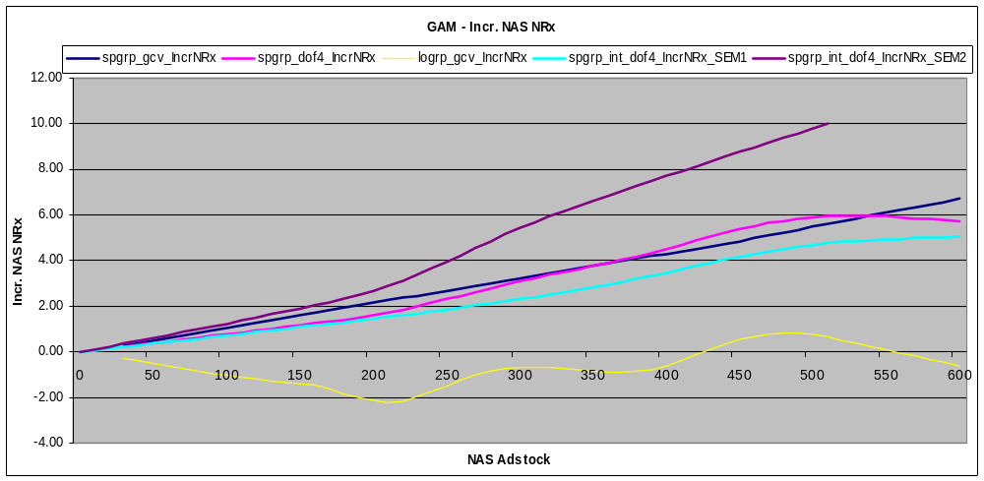
Semi-Parametric Methods [PROC GAM]
Blue – GRP NAS; Pink – GRP NAS(dof=4); Maroon – SEM2 GRPs; Light Blue – SEM1 GRPs; Yellow – GRP NAS (LOESS)
No clear saturations overall, though SEM1 shows some saturation far beyond its mean of (~275 Adstock).

Slide 38
Understanding Model Structures through Simulation

Slide 39
Need for Simulation
Sometimes during exploration, one may begin to wonder:
  Is model A better than model B?
  Is model A a subset of model B?
  Are model A’s estimates of interest influenced largely by some confounding effects rather than real effects?
One possible way to answer may be to run simulations (where truth could be specified and alternate models could be tried to observe its dynamics).
Simulations are usually time consuming and data needs to be generated that mimic the distributions, variances and covariances that exist in the real data.
Case in point:
  MODEL A: pnasnrx = t1 – t24 mc_nrp lag_pnasnrx detmd_30 sammd_80 grpomn_60 grpotc_60 grpnas_60.
  MODEL B: pnasnrx = t1 – t24 mc_nrp lag_pnasnrx detmd_30 sammd_80 grpomn_60 grpotc_60 grpnas_60_SEM1 grpnas_60_SEM2.
  If truth is Model B, can Model A represent it AND vice versa?
  This question was raised since SEM2’s effect was estimated to be higher in model B, however, model A’s overall estimate was very close to SEM1 estimates in model B. We began to wonder if the SEM2’s estimate in model B was due to confounding effects rather than real effects (given the data)

Slide 40
Simulation of Data
Simulating all independent variables that are very similar in distribution, variance, and covariance observed in real data is bit cumbersome (we do have some code for generating normal distributions with a given variance-covariance structure)
We took a shortcut to save time (not an ideal approach, but answered the question we had):
  Let us say we want to mimic Model A as the truth. First build Model A using real data, then take predicted value for each record. Then add a normal random error generated using mean 0 and variance corresponding to variance of residuals of model A. This new variable will be the simulated dependent variable. In other words, we retain the distribution, variance, and covariance of independent variables and we just add the randomized (uncorrelated) error variance seen in the data for dependent variable to create a simulated dependent variable.
  Then build Model A and Model B using the above dataset where true relationships are known apriori. Results from Model A would help us to understand if we are able to get back the results we mimicked. Results from MODEL B WOULD show us if Model B could represent Model A.
  This simulation was repeated 250 times for each model and the mean, Q1 and Q3 values of each estimate were used to compare Model A and Model B.
Through simulation, we observed that Model B was better suited and the Model A’s GRPNAS estimate was overly influenced by SEM1 campaign activities.

Slide 41
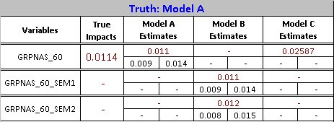
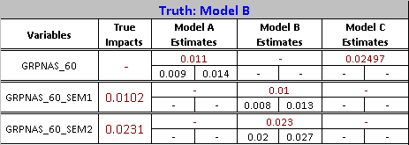

Results
  MODEL A: pnasnrx = t1 – t24 mc_nrp lag_pnasnrx detmd_30 sammd_80 grpomn_60 grpotc_60 grpnas_60.
  MODEL B: pnasnrx = t1 – t24 mc_nrp lag_pnasnrx detmd_30 sammd_80 grpomn_60 grpotc_60
  grpnas_60_SEM1 grpnas_60_SEM2.
  MODEL C: pnasnrx = workdays mar apr sep dec mc_nrp lag_pnasnrx detmd_30 sammd_80 grpomn_60 grpotc_60 grpnas_60.
Model B is able to represent Model A while the reverse is NOT true.
Model C is unable to represent Model A or Model B
In conclusion, structure of Model B is best of all three.

Slide 42
Exploring Residuals, Acceptable Covariance Structures and Half-Life’s (or Adstocks)

Slide 43
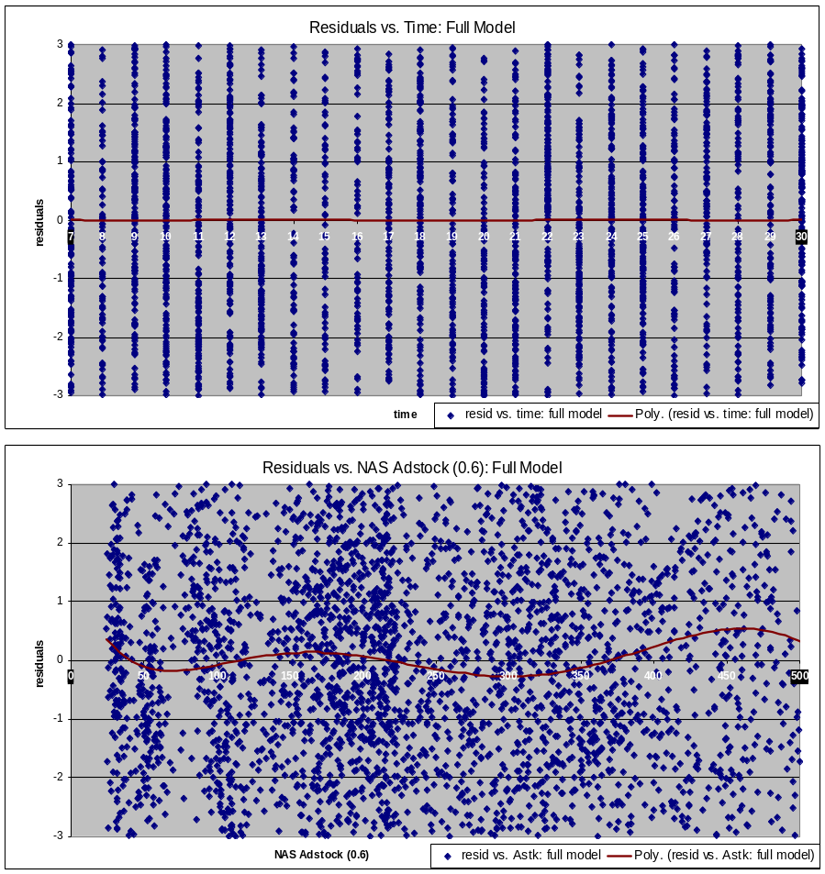
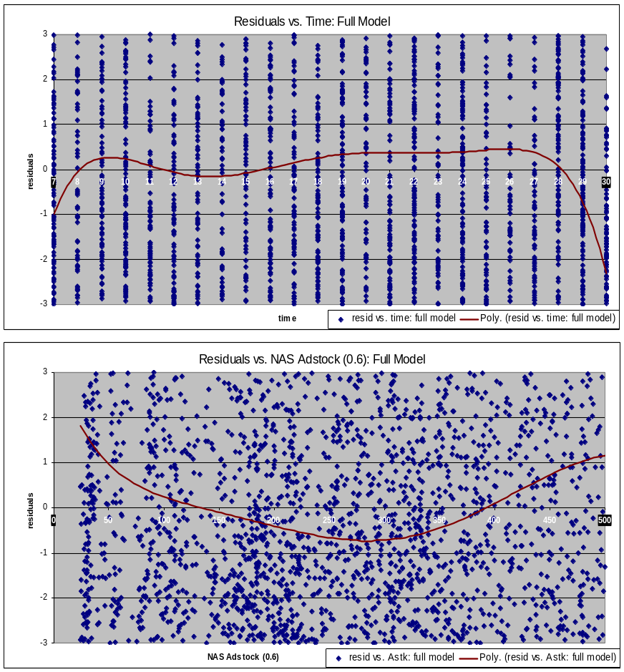
Randomness in Residuals from Models
Exploring Residuals of a model for randomness in different dimensions (like, time and GRPNAS) might help to identify further tuning of model structures. In the example below, Model A is better.
MODEL A (with time indicators): MODEL C (with seasonal indicators):
TIME vs. Residuals AND GRP vs. Residuals TIME vs. Residuals AND GRP vs. Residuals

Slide 44
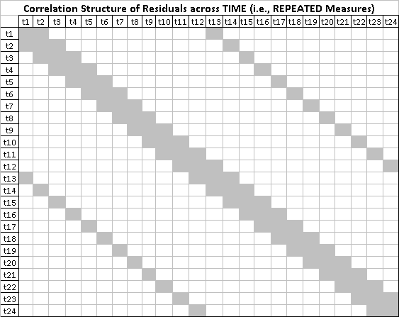
Repeated Measures Correlations of Residuals
For the selected model with no repeated measures covariance structures, we saw a residual correlation structure something similar to the one illustrated below (not exactly):
  A tight band across diagonal (AR??)
  Another band close to seasonal months
Introduce covariance structures for the repeated measures so that the final marginal residuals show no correlation.
Note: Refer to actual structures in the spread sheet.

Slide 45
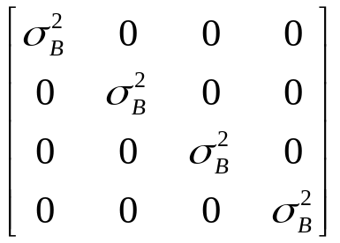
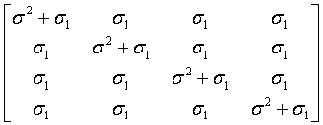
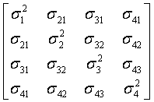
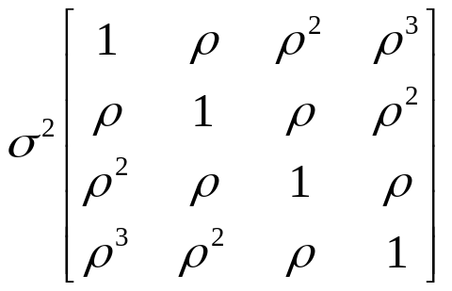
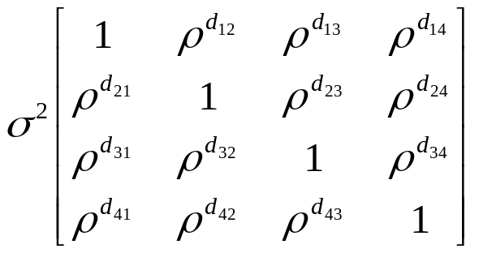
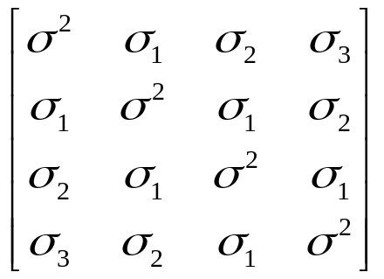
Covariance Structures - Examples
Variance Components
VC (default)
Compound Symmetry
CS
Unstructured
UN
First Order Auto Regressive
AR(1)
Toeplitz
TOEP
Spatial Power
SP(POW)(c)

Slide 46
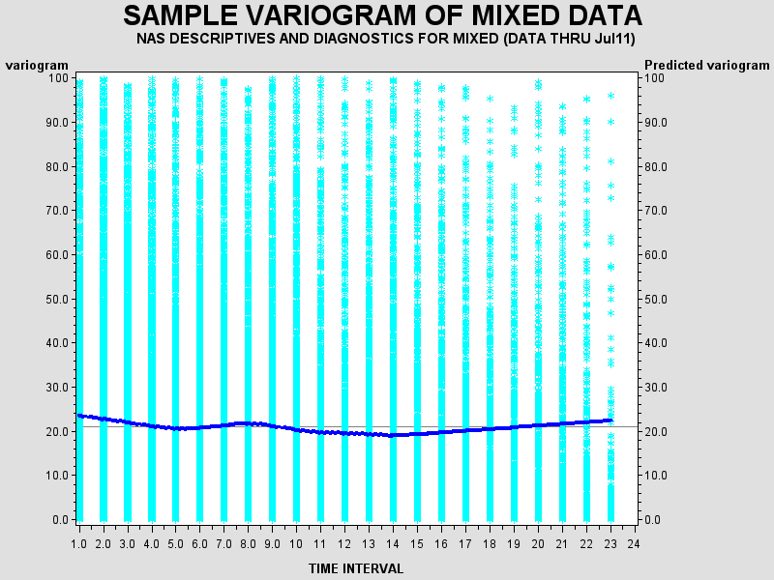
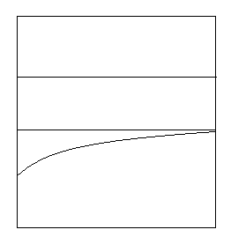
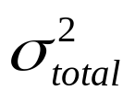



Variograms
Variograms (time vs. variance components) helps in visualizing the total variance and how they are split into component variances like Measurement Error, Repeated Measures and Random Component.
Variogram Macro provided by SAS is used to get the variograms for the given data.
Nasonex DTC data shows a large Measurement Error component and a small wavery Repeated Measures component. It appears that Random Effects Component exists within Measurement Error portion.

Slide 47
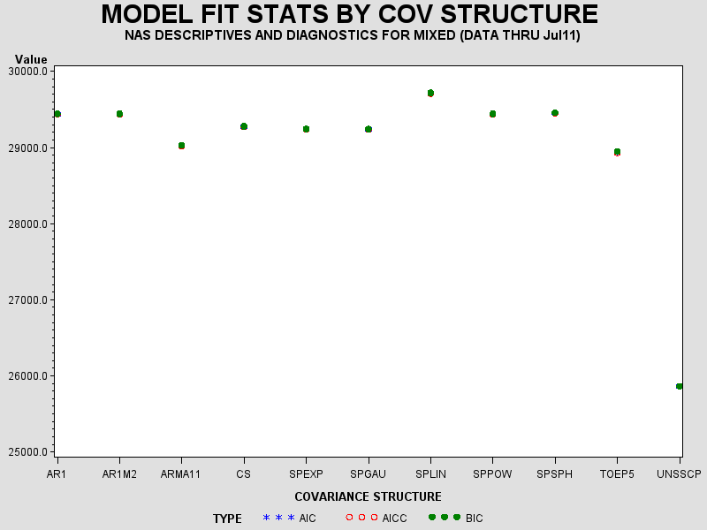
BIC’s from Various Repeated Measures Covariance Structures
Variogram Macro also produces BIC values generated by various Repeated Measures covariance structures.
Below, Unstructured (with SSCP option), TOEP5 and ARMA11 have lower BIC’s, but we do see some convergence issues (observed through exploration of residuals and observation of very different patterns and values in predicted covariance matrices)

Slide 48
Convergence Issues – Seems Common
Issues with Covariance Structures
  Lot of changes in estimated values, probably due to local convergence. Look for convergence issues in predicted covariances.
  BIC alone may not be an indicator of better model. Check to see if BIC, Estimate magnitudes and Signs makes some sense as well.
  Look if the final model marginal residuals (after introducing covariance structures) have no structure.
  When convergence is an issue, a simpler covariance structure may suffice (probably only option).
  At times, estimated G matrix is not positive definite that leads to NULL covariance estimate. Look to see if other covariance structures helps to address the issue.
Example:
  The Final Model covariance structure was chosen to be SP(EXP)(TIME). However, the exponential part of the estimate was null and Random Intercept covariance was predicted properly, effectively leading to a Random Intercept model.
  Without the SP(EXP)(TIME) structure for repeated measures, the Random Intercept variance was predicted to be NULL because of issues with G matrix. Hence above SP(EXP) structure was chosen.

Slide 49
Exploring Half-Life’s (or Adstocks)
Half-Life’s inform approximate decay rate for a given promotion.
GRID SEARCH is performed. Hence, several models (few hundreds?) needs to be run to choose appropriate decay rate for Details, Samples, GRPNAS, GRPOMN, GRPOTC and other promotions if any.
Sometimes, this exploration helps in obtaining significant promotion estimates with reasonable magnitude and sign (particularly for Details and Samples).
Criteria for selection: BIC’s, Estimate significance and sign and judgments on reasonableness of half-life’s. Usually, BIC changes are small.
Note: experience shows that ROI’s do not change much for various adjacent adstocks (though estimates might change).
GRID SEARCH Procedure (existing semi-automated macros could be reused):
  Start with most reasonable full model found from previous exploration.
  Take one promotion at a time, say Details. Have all other vars constant and for each model explore adstocks from, say, 10% decay rate to 90% decay rate (using macros).
  Look at the results in Excel, and make judgments on which Detail adstock is most reasonable and hold this.
  Then move to next promotion, say samples, and repeat the same exploration. Continue this until one round of exploration is complete.
  Now start the next round all over. Usually in about two to four rounds, we probably would settle in the most reasonable adstocks.

Slide 50
Influence Diagnostics and Outliers

Slide 51
Influence Diagnostics
Influence Diagnostics identifies Outlier DMA’s that unduly impacts the estimates (particularly GRPNAS).
PRCO MIXED has INFLUENCE option that generates many different statistics to identify outliers. Outliers could be classified in terms of:
  OVERALL Influence (look for high Restricted Likelihood Distance)
  Overall Influence can be categorized into:
    Fixed Estimates Influence (Look for Higher Cook's D)
    Fixed Estimates Significance Level or precision (Look for COVRATIO far from 1. High Covratio results in lower precision)
    Random/Error Covariance Parameter Estimates influence (Look for Higher Cook's D for COV. PARAMS)
    Random/Error Covariance Parameter Estimates precision influence (Look for COVRATIO far from 1. High Covratio results in lower precision)
Reference: http://www.stat.purdue.edu/~bacraig/notes598S/SUGI_Paper_Schabenberger.pdf
Note: Show some of the diagnostic charts from Excel.
Once Outliers are identified (usually a couple of DMA’s), remove them from data and run the final model again.

Slide 52
Final and Supporting Models

Slide 53
Final and Supporting Models
Final Model: Random Intercepts model achieved indirectly through SP(EXP)(TIME) covariance structure for repeated measures.
  In here, this model has independent random intercepts and independent measurement error components.
Supporting Models:
  S1. Full interactions random intercepts model: to verify how promotional estimates changes during sem1 and sem2 for all promotions.
  S2. Interaction model that differentiate 2011 vs. other time periods: To answer if 2011 45 seconds GRPs have different impact.
  S3. Fixed effects (Allison's) model that gets less biased estimates: To see if our RI model estimates are biased for TV GRP's
  S4. Semi Parametric GAM model: To differentiate the sem1 and sem2 Nasonex GRP responsiveness and see the presence of any non-linear structure.

Slide 54
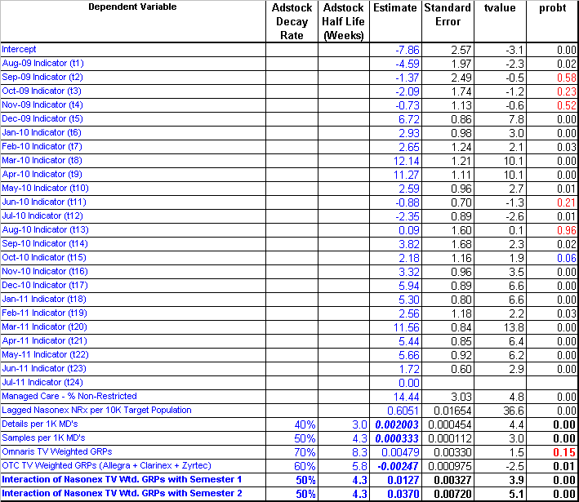
Final Model Estimates
Study Period: Aug-2009 to Jul-2011

